Slide 1
Used literature
COCKBURN, A. Use Cases Jak efektivně modelovat aplikace. CP Books, a.s., 2005. ISBN 80-251-0721-3.
FOWLER, M. UML Distilled: A Brief Guide to the Standard Object Modeling Language. Addison-Wesley Professional, 2003. ISBN 978-0321193681.
GAMMA, E., HELM, R., JOHNSON, R. AND VLISSIDES, J.M. Design Patterns: Elements of Reusable Object-Oriented Software. 1st ed.: Addison-Wesley Professional, 1994. ISBN 978-0201633610.
PFLEEGER, S.L. AND ATLEE, J.M. Software Engineering: Theory and Practice. Prentice Hall, 2009. ISBN 0136061699.
POHL, K. Requirements Engineering: Fundamentals, Principles, and Techniques. Springer, 2010. ISBN 978-3642125775
PRESSMAN, R.S. Software engineering : a practitioner's approach. 7th ed. New York: McGraw-Hill Higher Education, 2010. xxviii, 895 p. p. ISBN 9780073375977.
SOMMERVILLE, I. Software engineering. 9th ed. Harlow: Addison-Wesley, 2010. xxiii, 840 p. p. ISBN 978-0137035151.
WARMER, J. AND KLEPPE, A. The Object Constraint Language: Getting Your Models Ready for MDA. Addison-Wesley Professional, 2003. ISBN 0321179366.

Slide 2
Software engineering
The IEEE Computer Society defines software engineering as:
“(1) The application of a systematic, disciplined, quantifiable approach to the development, operation, and maintenance of software; that is, the application of engineering to software.
(2) The study of approaches as in (1).”1

Slide 3
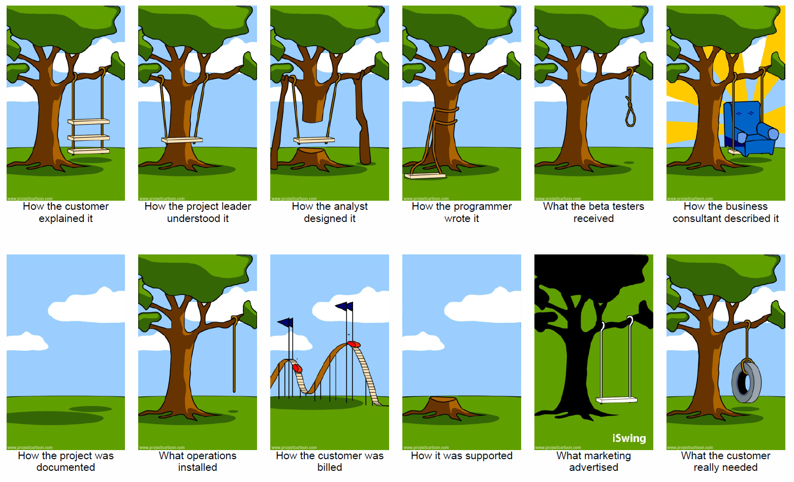
Software development „reality“

Slide 4


Users‘ vs. developers‘ view
How developers see users
Users don’t know what they want.
Users can’t articulate what they want.
Users are unable to provide usable statements of needs.
Users have too many needs that are politically motivated.
Users want everything right now.
Users can’t remain on schedule.
Users can’t prioritize needs.
Users are unwilling to compromise.
Users refuse to take responsibility for the system.
Users are not committed to development projects.
How users see developers
Developers don’t understand operational needs.
Developers can’t translate clearly stated needs into a successful system.
Developers set unrealistic standards for requirements.
Developers place too much emphasis on technicalities.
Developers are always late.
Developers can’t respond quickly to legitimately changing needs.
Developers are always over budget.
Developers say “no” all the time.
Developers try to tell us how to do our jobs.
Developers ask users for time and effort, even to the detriment of the user’s important primary duties.

Slide 5
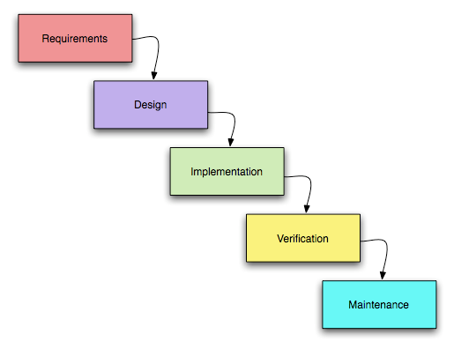
Software process – key disciplines

Slide 6
Requirement specifications
Requirements expressed in :
Natural language sentences
Structured natural language
Design description language
Graphical notations
Formal specifications

Slide 7
Requirements
Requirement is
A condition or capability needed by a user to solve a problem or achieve an objective.
A condition or capability that must be met or possessed by a system or system component to satisfy a contact, standard, specification, or other formally imposed documents.
A document representation of a condition or capability as in (1) or (2).
Requirement artifact is a documented requirement.
Requirement types:
Functional requirements
Quality requirements
Constraints.

Slide 8
SRS should be
Correct
Unambiguous
Complete
Consistent
Ranked for importance and/or stability
Verifiable
Modifiable
Traceable

Slide 9
Functional requirements
Functional requirements are statements of services that a system should provide, how the system should react to particular inputs and how the system should behave in a particular situation. In some cases, functional requirements may also state what the system should not do.
Example: If a sensor detects that a glass pane is damaged or broken, the system shall inform the security company,
Mainly defines: data, functions, and behavior.

Slide 10
Quality requirements I
A quality requirement defines a quality property of the entire system or of a system component, service, or function.
Types of quality requirements
Important primarily for developers
Maintainability
Portability
Reusability
Testability
Important primarily for users
Availability
Efficiency
Flexibility
Integrity
Interoperability
Reliability
Robustness
Usability
Notes:
Availability
Availability refers to the percentage of time during which the system is actually available for use and fully operational.
Is there a maximum time allowed for restarting the system after a failure.
How often will the system be backed up?
Must backup copies be stored at a different location?
Must the system detect and isolate faults?
What is the described mean time between failures?
Should precautions be taken against fire or water damage?
Efficiency (performance)
Efficiency is a measure of how well the system utilizes hardware recources such as processor time, memory,, or communication bandwidth.
Are there constraints on execution speed, response time or throughput?
What efficiency measures will apply to resource usage and response time?
How much data will flow through the system?
How often will data be received or sent?
Flexibility
It indicates how much effort is needed to extend the system with new capabilities.
Integrity (Security)
Integrity denotes how well the system is protected against unauthorized access, violations of data privacy, information loss, and infections through maleficent software.
Must access to the system or information be controlled?
Should each user’s data be isolated from the data of the other user?
Should user programs be isolated from other programs and from the operating system?
Should precautions be taken against theft or vandalism?

Slide 11
Quality requirements II
A quality requirement defines a quality property of the entire system or of a system component, service, or function.
Types of quality requirements
Important primarily for developers
Maintainability
Portability
Reusability
Testability
Important primarily for users
Availability
Efficiency
Flexibility
Integrity
Interoperability
Reliability
Robustness
Usability
Notes:
Interoperability
It indicates how easily the system can exchange data or services with other systems.
Reliability
Reliability is the probability of the system executing without failure for a specific period of time.
Robustness
Robustness is the degree to which a system or component continues to function correctly when confronted with invalid inputs, defects in connected systems or components, or unexpected operating conditions.
Usability and human factors
Usability measures the effort the user requires to prepare input for, operate, and interpret the output of the system.
What kind of training will be required for each type of user?
How easy should it be for a user to understand and use the system?
How difficult should it be for a user to misuse the system?
Precision and Accuracy
How accurate must data calculations be?
To what degree of precision must calculations be made?

Slide 12
Quality requirements III
A quality requirement defines a quality property of the entire system or of a system component, service, or function.
Types of quality requirements
Important primarily for developers
Maintainability
Portability
Reusability
Testability
Important primarily for users
Availability
Efficiency
Flexibility
Integrity
Interoperability
Reliability
Robustness
Usability
Notes:
Maintainability
It indicates how easy it is to correct a defect or make a change in the system.
Will maintenance merely correct errors, or will it also include improving the system?
When and in what w!!ays might the system be changed in the future?
How easy should it be to add features to the system?
Portability
It relates to the effort it takes to migrate a system or component form operating environment to another.
How easy should it be to port system from one platform (computer, OS) to another?
Reusability
It indicates the extent to which a component can be used in systems other than the one for which it was initially developed.
Testability
It refers to the ease with which the software components or integrated system can be tested to find defects.

Slide 13
Non-functional requirements
Non-functional =
Underspecified functional requirements
Quality requirements
The system shall be secure.
Each user must log in to the system with their user name password prior to using the system.
The system shall remind the user every four weeks to change the password.
When the user changes the password, the system shall validate that the new password is at least eight characters long and contains alphanumeric characters.
Users‘ password stored in the system must be protected against password theft.

Slide 14
Constraints I.
A constraint is an organizational or technological requirement that restricts the way in which the system shall be developed.
Organizational process
Resources
Documentation
Standards
Design (operational environment)
Physical environment
Interface
Users
Notes:
Process
Resources
What materials, personnel, or other resources are needed to build the system?
What skills must the developer have?
Documentation
How much documentation is required?
Should it be online, in book format, or both?
To what audience should each type of documentation be addressed?
Standards

Slide 15
Constraints II
A constraint is an organizational or technological requirement that restricts the way in which the system shall be developed.
Organizational process
Resources
Documentation
Standards
Design (operational environment)
Physical environment
Interface
Users
Notes:
Design
Physical environment
Where is the equipment to be located?
Is there one location or several?
Are there any environment restrictions, such as temperature, humidity, or magnetic interference?
Are there any constraints on the size of the system?
Are there any constraints on power, heating, or air conditioning?
Are there constraints on the programming language, because of the existing software components?
Interface
Is input coming from one or more other systems?
Is output going to one or more other systems?
Is there a prescribed way in which input/output data must be formatted?
Is there a prescribed medium that the data must use?
Users
Who will use the system?
Will there several types of users?
What is the skill level of each user?

Slide 16
Constraints III
A constraint is an organizational or technological requirement that restricts the way in which the system shall be developed.
Organizational process
Resources
Documentation
Standards
Design (operational environment)
Physical environment
Interface
Users
Constraints affecting the system:
With respect to current conditions defined by the insurance company, only the security technicians are allowed to deactivate the control function of the system.
A fire protection requirement demands that terminals in the sales rooms do not exceed the size 120cm x 90 cm x 20 cm.
Constraints affecting the development process:
The effort for development of the system must not exceed 480 man-months,
The system must be developed using RUP.

Slide 17
Creation of textual requirement I
oug
deletion
T o g s
h u t
distortion
Thoughts
generalization
Specific thoughts
Notes:
Generalization
Universal quantifications –
Indicated with words all, every, always, nobody, never, no one.
Example: Every, wants to borrow a book, must have an identity card
It is questioned by: ”Has there ever been a time when … ”
Modal operator possibility
It defines what is considered to be possible/impossible.
Example: “Manager cannot enter delete order.”
It is clarified by asking: ”What would happen if you did … ?” “What prevents you … ?”
Model operator of necessity
It involves a need and are indicated by use of words like, “should”, “should not”, “must” and “must not”, “ought” and “ought not”.
Example: “User must enter his e-mail”.
It is clarified by asking: “What would happen if he did not.”

Slide 18
Creation of textual requirement II
oug
deletion
T o g s
h u t
distortion
Thoughts
generalization
Specific thoughts
Notes:
Distortion
Complex equivalence
Readers cannot borrow a book if they have a book with expired time.
Presuppositions
There are hidden presuppositions in sentences.
Example:
It is questioned: What leads you to believe that … ?
Cause and effect –
There are defined causalities between actions and human feeling in sentences.
Example:
It could be questioned by asking: ”How exactly does this cause that?”
Mind reading –
We presume to know, without direct evidence, what others think or feel.
Example: If a user forgets to close an order, then the system reminds him every day by e-mail.
It is questioned by asking: “How exactly do you know…?”

Slide 19
Creation of textual requirement III
oug
deletion
T o g s
h u t
distortion
Thoughts
generalization
Specific thoughts
Notes:
Deletion –
System is used for book borrowing
Unspecified noun
There is not a noun specified in the sentences.
“Password strong is accepted and then is changed in database.”
It is questioned by asking: “Who or what specifically?”
Unspecified verb
Verb doesn’t specify how the action should be done.
Example: System chekcs ID according to the birthday.
It is questioned by asking: “How specifically?”
Comparison
There is a comparison being made here, but this is not made clear.
Example: “Calculation of provision is more brisk.”
It is clarified by asking:” Compared with what…”.
Judgment
Judgments are closely allied to comparisons – no need to involve it, although they often do. Missing information about persons who made the judgment that is hidden in.
Example:
It is clarified by asking: “who is making this judgment, and what grounds are they making it on?”
Nominalization
Verb is transcribed to noun. This noun is virtual – cannot be felt, touched, smelled, who actual order
Example:
“accountant is responsible for invoice editing”
“System is used for borrowing.”
It is clarified by asking: ”Who is nominalizing about what, and how they are doing it.”

Slide 20
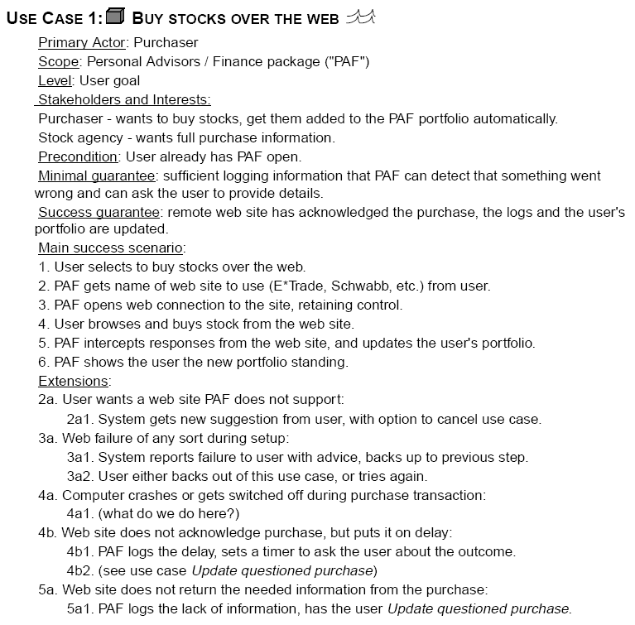
Use cases
Use case is specification of a sequence of actions, including variants that a system (or other entity) can perform, interacting with actors of the system.
Benefits:
goal identification,
exceptional situation.
Notes:
It is a contract between the stakeholders of the system about its behavior.
It shows how a system responds to a request from one of the stakeholders, called the primary actor.
The primary actor initiates an interaction with the system.
Use cases are mainly described in a text form but it could be written using flow charts, sequence charts, Petri nets, or programming languages. Text is preferred – it is untestable by stakeholders.
History
Ivar Jacobson invented use cases (in 1960s). He worked on telephony systems at Ericsson. Two decades later, his use cases were introduced on OOPSLA to the community of object-oriented developers.

Slide 21
Requirements and use cases
They are really requirements
Cover only a part of requirements – it lacks:
External interface,
Data format
Business rules,
Complex formulae.
Cover one third of all requirements.
Notes:
They express real requirements and they don’t need alternative way of representation. They properly describe what system should do.
They don’t express all of the requirements. They captures only one third of all requirements that need to be captured. They miss:
detail external interfaces;
data formats;
business rules;
complex formulae.

Slide 22
Use case structure
Scope: <design scope, what system is being considered black-box under design>
Level: <one of: Summary, User-goal, Subfunction>
Primary Actor: <a role name for the primary actor, or description>
Stakeholders & Interests: <list of stakeholders and key interests in the use case>
Precondition: <what we expect is already the state of the world>
Minimal Guarantees: <how the interests are protected under all exits>
Success Guarantees: <the state of the world if the goal succeeds>
Notes:
Scope identifies the system that is developed.
Primary actor is actor that initiates use case.
Preconditions and guarantees define condition that should be satisfied before and after the use case runs.
Level defines level of the goal.
The main success scenario is a case in which everything is successfully performed.

Slide 23
Primary actors and stakeholders gathering
Actors have goals supported by described system. The system should ensure interests of stakeholders.
Interactions between Actors with Goals
Actors have goals
Goals can fail
Interactions are compound
A use case collects scenarios
Contract between Stakeholders with Interests
Notes:
Their gathering is important because users have goals and will use constructed system to achieve their goal. Users are suitable sources of use cases – use cases correspond to the supported user goals.
Use case execution should ensure that stakeholder interests are preserved

Slide 24
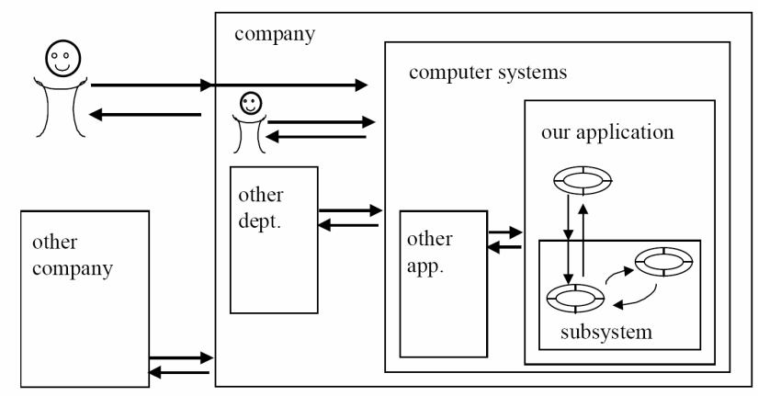
Design scope I
Design scope is the extent of the system
Notes:
Design scope is the extent of the developed system. It is the class of systems, hardware and software, that are considered during development. It is system‘s boundary. It is very important for the writer and reader to understand the same design scope of the system.

Slide 25


Design scope II
"Enterprise" scope
"System" scope
"Subsystem" scope
Notes:
We should give proper names to important system parts to distinguish between them.
What can we do to clear up these misunderstandings?
"Enterprise" scope describes the behavior of the entire organization or enterprise in providing of the goal of the primary actor (of the whole enterprise).
It is better to name this scope with the company name to prevent misunderstanding.

Slide 26

Design scope III
"Enterprise" scope
"System" scope
"Subsystem" scope
Notes:
"System" scope defines a part of hardware/software you are developing. Outside the use case are all the parts of other systems that communicate with this through an interface.

Slide 27

Design scope IV
Design scope is the extent of the system
"Enterprise" scope
"System" scope
"Subsystem" scope
Notes:
"Subsystem" scope defines only limited parts of the system – it shows how these work together.
It is useful to attach a graphic symbol to the left of the use case title.
Use cases should be written from black box or white box perspective. In black box perspective, we are not interested how the system works whilst in a white-box perspective we do.

Slide 28
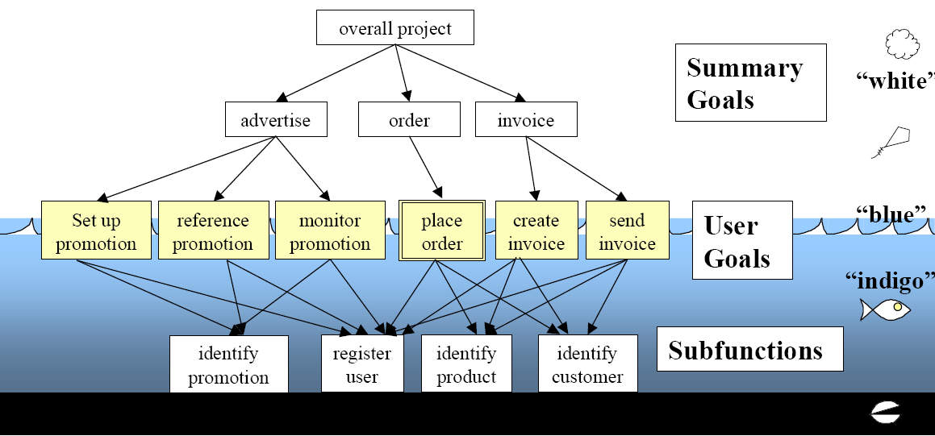
THREE NAMED GOAL LEVELS
Notes:
Level of goals depicts activities on different level of abstraction and helps to understand them.

Slide 29
THREE NAMED GOAL LEVELS II
Notes:
The user goal is the goal of the greatest interest. It is the goal of the primary actor. He is working with the system to satisfy his needs. It defines "elementary business process" in the business process engineering literature.
It will be defined by question "Can the primary actor go away happy after having done this?" For an accountant, it would be, "Sending invoice to a customer".
It is performed by one person.
It holds one sitting (2-20 minutes

Slide 30
THREE NAMED GOAL LEVELS III
Notes:
Summary-level goal contains more than one user goal. It is used to describe system:
It shows the context in which the user goals operate,
It shows life-cycle sequencing of related goals,
It provides a list of lower-level use cases.
It is performed by more than one person.
It is typically executed over hours, days, weeks, months, or years.

Slide 31
THREE NAMED GOAL LEVELS IV
Notes:
Subfunction-level goals are executed during use case-s on user level. It is necessary to define them to improve readability or if many use cases use them. Examples of subfunction use cases are "Find a customer", "Sort a table", "Log into a system."

Slide 32
Use case structure I
Context of use: <a longer statement of the goal, if needed, its normal occurrence conditions>
Scope: <design scope, what system is being considered black-box under design>
Level: <one of: Summary, User-goal, Subfunction>
Primary Actor: <a role name for the primary actor, or description>
Stakeholders & Interests: <list of stakeholders and key interests in the use case>
Precondition: <what we expect is already the state of the world>
Trigger: <what starts the use-case may be a time event>
Minimal Guarantees: <how the interests are protected under all exits>
Success Guarantees: <the state of the world if the goal succeeds>
Notes:
Preconditions
The Precondition of the use case defines what condition should be satisfied before the use case can start. They are not checked in use case again. A common example is, "the user has already logged on and has been authorized".
Generally, a precondition indicates that some other use case has already run, to set up the condition.
Triggers
The Trigger defines what event start the use case. Sometimes the trigger precedes the first step of the use case. Sometimes it is the first step of the use case.

Slide 33
Use case structure II
Context of use: <a longer statement of the goal, if needed, its normal occurrence conditions>
Scope: <design scope, what system is being considered black-box under design>
Level: <one of: Summary, User-goal, Subfunction>
Primary Actor: <a role name for the primary actor, or description>
Stakeholders & Interests: <list of stakeholders and key interests in the use case>
Precondition: <what we expect is already the state of the world>
Trigger: <what starts the use-case may be a time event>
Minimal Guarantees: <how the interests are protected under all exits>
Success Guarantees: <the state of the world if the goal succeeds>
Notes:
Minimal Guarantees
The Minimal Guarantees are the least promises the system makes to the stakeholders in every case even when the primary actor’s goal cannot be provided.
The Minimal Guarantee is written as a number of simple assertions.
Minimal Guarantee: Order will be initiated only if payment received.
The acceptance test for them is that the stakeholders would agree that their interests had been protected under all condition.

Slide 34
Use case structure III
Context of use: <a longer statement of the goal, if needed, its normal occurrence conditions>
Scope: <design scope, what system is being considered black-box under design>
Level: <one of: Summary, User-goal, Subfunction>
Primary Actor: <a role name for the primary actor, or description>
Stakeholders & Interests: <list of stakeholders and key interests in the use case>
Precondition: <what we expect is already the state of the world>
Trigger: <what starts the use-case may be a time event>
Minimal Guarantees: <how the interests are protected under all exits>
Success Guarantees: <the state of the world if the goal succeeds>
Notes:
Success Guarantee
The Success Guarantee states what interests of the stakeholders are satisfied after a successful execution of the use case. The Success Guarantee is generally written to add onto the Minimal Guarantee: all of the Minimal Guarantee is delivered, and some extra conditions are true.
The acceptance test for the Success Guarantee section is that the stakeholders agree that their interests have been satisfied by use case execution.
The best way to uncover the success guarantee is to ask, "What would make this stakeholder unhappy at the end of a successful run?"

Slide 35
Scenarios and steps I
Main success scenario – a typical scenario in which the primary actor’s goal is delivered and stakeholder‘s interests are satisfied
Common surrounding structure
Condition of scenario
a goal to achieve
a set of action steps
an end condition,
a possible set of extensions.
The scenario body
an interaction between two actors,
a validation step to protect an interest of a stakeholder,
an internal change to satisfy a stakeholder.
Notes:
Main success scenario
It describes a fairly typical scenario in which the primary actor’s goal is delivered and all stakeholders’ interests are satisfied.

Slide 36
Scenarios and steps II
Main success scenario
Common surrounding structure
condition of scenario
goal to achieve
set of action steps
end condition,
possible set of extensions.
The scenario body
an interaction between two actors,
a validation step to protect an interest of a stakeholder,
an internal change to satisfy a stakeholder.
Notes:
The main success scenario and scenario extensions sit within the same structure. That consists of:
A condition under which the scenario runs. For the main success scenario, this is the use case precondition plus the use case trigger. For an extension scenario, this is the extension condition (perhaps with the step number or place in the scenario where that condition applies).
A goal to achieve. For the main success scenario, this is exactly the use case name, satisfying, of course, the stakeholders’ interests. For an extension scenario, the goal is either to complete the use case goal or to rejoin the main success scenario after handling the condition.
A set of action steps. These form the body of the scenario, and follow the same rules in every scenario or scenario fragment.
An end condition. The goal is achieved at the end of the main success scenario. A scenario fragment may end with the goal either being achieved or abandoned.
A possible set of extensions, written as scenario fragments. Extensions to the main success scenario are placed in the Extensions section of the use case template. Extensions to extensions are placed directly inline, inside or just after the extension body

Slide 37
Scenarios and steps III
Main success scenario
Common surrounding structure
Condition of scenario
a goal to achieve
a set of action steps
an end condition,
a possible set of extensions.
Scenario body
interaction between two actors,
validation step to protect interest of the stakeholder,
internal change to satisfy the stakeholder.
Notes:
Every scenario or fragment is written as a sequence of goal-achieving actions by the various actors.

Slide 38
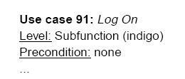
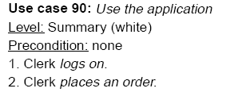
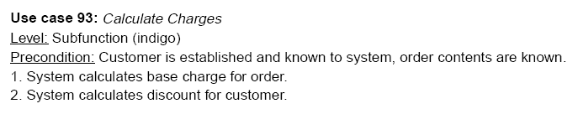
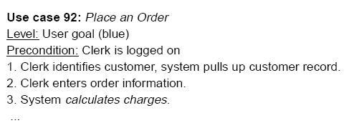
Different level of goals and precondition
The use case on the summary level gives context for use-cases on lower levels.
The precondition indicates the use-case performed previously.
Notes:
As we have already said, a precondition indicates that some other use case has already run, to set up the condition.
Place an Order, relies on a precondition ("logged on"). It indicates that some use case was executed a produced state in which a user is logged. A higher-level use case that mentions both use cases could be created - Use the application.

Slide 39
Action Steps – guideline 1: It uses simple grammar
Subject ... verb... direct object... prepositional phrase.
Example:
The system ... computes ... provision... from the invoiced amount.
Notes:
The sentence structure should be very simple:
Subject ... verb... direct object... prepositional phrase.
Example: The system ... computes ... provision... from the invoiced amount.

Slide 40
Action Steps – guidelines 2: It shows clearly, "Who has the ball“.
At each step one actor "has the ball". That actor is going to be the subject of the sentence, the first actor named, probably as the first or second word in the sentence.
The "ball" is the message and data that gets passed from actor to actor.
Notes:
A useful visual image is that of friends battering a soccer ball around. Sometimes person 1 kicks it to person 2, and then person 2 dribbles it a while, then kicks it to person 3. Occasionally it gets muddy, and one of the players wipes the mud off.
A scenario has the same structure. At each step one actor "has the ball". The "ball" is the message and data that gets passed from actor to actor.

Slide 41
Action Steps – guidelines 3: It is written from a bird's eye point of view.
Beginning use case writers write the scenario as seen by the system:
Get an ATM card and PIN number. Deduct the amount from the account balance. X
A better form is:
The customer inserts the ATM card and PIN.
The system deducts the amount from the account balance.
v
Notes:
Beginning use case writers, particularly programmers who have been given the assignment of writing a use case document, often write the scenario as seen by the system, looking out at the world, and talking to itself.
The sentences have the appearance: "Get ATM card and PIN number. Deduct amount from account balance."
Write the use case from a bird's eye point of view:
The customer puts in the ATM card and PIN.
The system deducts the amount from the account balance.

Slide 42
Action Steps - guideline 4: It shows the process moving distinctly forward
Avoid small steps – find a slightly higher-level goal for a step, ask "Why is the actor doing that?“.
Example:
A user hits the tab key.
Why is the user hitting the tab key? To get to the address field.
Why is he trying to get to the address field? Because he has to enter her name and address before the system does anything.
A user enters name and address.
Notes:
The amount of progress made in one step is related to how high or low the use case goal is. In the
summary or user level of use case, the step probably moves forward the entire user goal. In a subfunction use case, it moves forward a much smaller amount.
If we see the step "User hits the tab key", either it indicates a subfunction level of the goal or the writer has chosen too small level of an action to describe.
Choosing very small steps causes uselessly long use cases - if a use case has 13 or 17 steps, it often indicates steps on very low level of actions.
Example:
User hits tab key.
Why is the user hitting the tab key?
To get to the address field.
Why is he trying to get to the address field?
Because he has to enter her name and address before the system does anything.
Actually, it is a written level of action -
User enters name and address.

Slide 43
Action Steps – guidelines 5: It shows the actor’s intentions, not movements.
It is user interface designer’s job to invent a user interface but we are interested in the semantic description of the interface in the requirements document
1. System asks for name.
2. User enters name.
3. System prompts for address.
4. User enters address.
5. User clicks ’OK’.
6. System presents user’s profile.
1. User enters name and address.
2. System presents user’s profile.
more data items being passed
Customer enters name, address, phone number, secret information, emergency contact phone number.
Customer enters
- name
- address
- phone number
- secret information
- emergency contact phone number
Notes:
Describing the user’s movements during using of user interface is one of the more common mistakes – it causes writing goals at too low level.
Effective user interface is invented by designer not by analyst – writer of the use case.

Slide 44
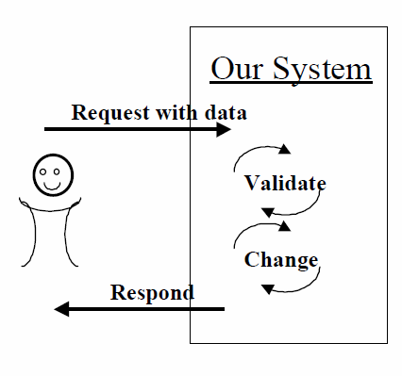
Action Steps – guidelines 6: It contains a ’reasonable’ set of actions.
The primary actor sends a request and data to the system.
The system validates the request and the data.
The system alters its internal state.
The system replies to the actor with the result.
Version 1 – All interaction are in one step.
Version 2 – a/ 1. b/ 2., 3., 4.
Version 3 – a/ 1. b/ 2. c./ 3., 4.
Version 4 – a/ 1. b/ 2. c./ 3. d/ 4.
Version 5 – a/ 1. b/ 2. c./ 3. d/ 4( to an actor a) e/ 4 (to an actor b)
Notes:
Ivar Jacobson has described a step in a use case as representing a transaction where 4 types of interaction should perform.
5 variants of their composition could be identified and none of them is wrong: 1 is too complicated to read easily. Version 2 is good when the pieces are simple but could be complicated. Version 3 is often preferred. Version 4 is also good. Action steps in version 5 are a bit too small, making the scenario too long. However, version 5 does have the advantage – steps are separated and can be easily tested.

Slide 45
Action Steps – guidelines 7: It doesn’t "check whether", it "validates“
Verifying step is often written as
“System … checks”
it is not a good action verb because it does not move process distinctly forward – it is followed by
“If the (condition) … ”
2. The system checks whether the password is correct
3. If it is, the system presents available actions to the user.
2. The system validates that the password is correct.
3. The system presents available actions to the user.
Notes:
One kind of interaction step verifies that some business rule is satisfied. Common mistake is that people write that the system checks the condition. This is not a good action verb - it does not move the process distinctly forward. After checking, you immediately have to write "If the check passes..." and "If the check fails".
Better formulation is establishing or validating or ensuring something – they are good goal achieving action verbs.

Slide 46
Action Steps – guidelines 8: It optionally mentions the timing
Feel free to put in the timing, but only when you need to.
At any time between steps 3 and 5, the user will ...
As soon as the user has ..., the system will ...
Notes:
One step usually follows another step in the scenario. Sometimes, you need to write:
At any time between steps 3 and 5, the user will ..
or
As soon as the user has ..., the system will ...
Use this construction when you need it but sometimes it is not necessary to mention it.

Slide 47
Action Steps – guidelines 9: Idiom: "User has System A, kick System B“
The user hits the FETCH button, at which time the system fetches the data from system B.
4. The user signals to the system to fetch data from system B.
5. The system fetches the background data from system B."
4. The user has system A, fetch data from system B.
Notes:
You want the developed system to fetch information from system B, or run an interaction with system B. It should only do so when the primary actor says to system A that it is time to do so. It is not very clear to write, "An accountant hits FETCH button, at which time the system fetches the data from system B." – it contains a description of user interface.
Note: Comment example.
This text indicates that the user defines the timing, the ball passes from the user to the system A to system B and shows the responsibilities of all three actors (user, system A, System B). The details of how the user fires the action is unspecified as it should be.

Slide 48
Action Steps – guidelines 10: Idiom: "Do steps x-y until condition"
only one step being repeated
"The user selects one or more products."
"The user searches through various product catalogs until he finds the one he wants to use.„
several steps to be repeated
1. The customer supplies either the account identifier or name and address.
2. The system brings up the customer's preference information.
3. The user selects an item to buy, marks it for purchase.
4. The system adds the item to the customer's "shopping cart".
The customer repeats steps 3-4 until indicating that he/she is done.
5. The customer purchases the items in the shopping cart (see use case xxx).
Notes:
Occasionally, some steps can be repeated. Writing a use case as plain prose has an advantage again – we simply mark which step and when repeat.

Slide 49
Action Steps – guidelines 10: Idiom: "Do steps x-y until condition“ - II
Variant – “Steps x-y can happen in any order.”
1. The customer logs on
2. The system presents available products and services.
Steps 3-5 can happen in any order.
3. The user selects products to buy.
4. The user specifies the preferred form of payment.
5. The user gives the destination address.
6. The user indicates shopping spree is complete.
7. The system initiates an order with the selected products to be charged against the form of payment and to be sent to the destination address.
Notes:
A variant of the previous is "Steps x-y can happen in any order." – it doesn’t define a loop.

Slide 50
Extensions I
write every scenario individually – bad maintenance
use “if” statements through text - hard to read
write a scenario extension for each branch point - best
Notes:
A scenario is a sequence of steps. Use case should contain all of the scenarios, both success and failure. There are three approaches how to write another scenario (besides the main)
To write every scenario individually - it is a maintenance nightmare - each change to a scenario has to be copied to all the other scenarios that contain the same text.
To write if statements throughout the text: "If the password is good, the system does ..., otherwise the system does.... "- hard to read especially if inside an if. Reader loses track of the behavior after just two “if” branches, and most use cases contain many branching points.
To write the main success scenario as a simple sequence running from trigger to completion, and then write a scenario extension for each branch point.

Slide 51
Extensions II
write every scenario individually – bad maintenance
use “if” statements through text - hard to read
write a scenario extension for each branch point - best
...
3. The system goes through the document, checking every word against its spelling
dictionary.
4. The system detects a spelling mistake, highlights the word and presents a choice of
alternatives to the user.
5. The user selects one of the choices for replacement. The system replaces the highlighted
word with the user’s replacement choice.
...
Extensions;
4a. The system detects no more misspellings through the end of the document:
4a1. The system notifies the user, terminates use case.
5a. The user elects to keep the original spelling:
5a1. The system leaves the word alone and continues.
5b. The user types in a new spelling, not on the list:
5b1. The system revalidates the new spelling, returns to step 3.

Slide 52
Extensions Conditions
condition under which the system takes different behavior.
say extension instead of failure or exception
4. The user has the system save the work so far.
...
Extensions;
4a. System auto detects the need for an intermediate save:
4a1. ...
4b. Save fails:
4b1. ...
Notes:
Extension conditions define when the system performs in a different behavior. We say extension but not failure or exception - we can include alternative success as well as failure conditions.

Slide 53
Brainstorm all conceivable failures and alternative courses I
Alternate success path - "Clerk uses a shortcut code".
The primary actor behaves incorrectly - "Invalid password".
Inaction by the primary actor - "Time-out waiting for password".
Every occurrence of the phase "the system validates" implies there will be an extension to handle failure of the validation - "Invalid account number".
Inappropriate or lack of response from a supporting actor - "Time-out waiting for response“
Internal failure within the system under design, which must be detected and handled as part of normal business - "Cash dispenser jams“.
Unexpected and abnormal internal failure, which must be handled and will have an externally visible consequence - "Corrupt transaction log discovered".
Critical performance failures of the system that you must detect. - "Response not calculated within 5 seconds".
Notes:
It is important to have good coverage of the extension conditions before definition of an alternative scenario. Brainstorming is used – it is tiring and so is documenting handling of the extensions.
On the other hand, having all of the alternative success and failure situations means to have a list of tasks of your work for next several hours or days.

Slide 54
Brainstorm all conceivable failures and alternative courses II
Alternate success path - "Clerk uses a shortcut code".
The primary actor behaves incorrectly - "Invalid password".
Inaction by the primary actor - "Time-out waiting for password".
Every occurrence of the phase "the system validates" implies there will be an extension to handle failure of the validation - "Invalid account number".
Inappropriate or lack of response from a supporting actor - "Time-out waiting for response“
Internal failure within the system under design, which must be detected and handled as a part of normal business - "Cash dispenser jams“.
Unexpected and abnormal internal failure, which must be handled and will have an externally visible consequence - "Corrupt transaction log discovered".
Critical performance failures of the system that you must detect. - "Response not calculated within 5 seconds".

Slide 55
Action Steps – guidelines 11: The condition says what was detected.
Write down what the system detects, not just what happened.
put a colon (’:’) after the condition
Customer forgets PIN.
PIN entry time-out.
Invalid PIN:
Network is down:
The customer walked away (time-out):
Cash did not eject properly:
Notes:
The system can’t detect that users forgot their PIN. Perhaps they walked away, had a heart attack, or are busy quieting a crying baby. What is the system able to detect in this case? Passivity, which really means it detects that the time limit has been exceeded.
A colon (’:’) put after the condition means that the reader doesn’t accidently think it is an action step.

Slide 56
Extension optimization
Rationalize the extensions list.
The system must be able to detect the condition.
The system must be obliged to handle detecting the condition.
Roll up failures
Use Case: Update Investment
...
7. The user has PAF save the work.
8. ...
Extensions:
7a. Save fails:
7a1. ...whatever should happen next...
Use Case: Save Work
...
Extensions:
3a. File already exists (user doesn't want to overwrite): ...
3b. Directory not found: ...
4a. Out of disk space: ...
4b. File write-protected: ...
... and so on...
Notes:
Rationalize the extensions list.
Reduction - The ideal extension conditions list shows all the situations the system must to handle and no more.
Roll up failures
Conditions from lower level are merged in one that has the same effect on a higher level – it prevents having an explosion of extension condition at the higher level.
Failures are reported in vocabulary appropriate for the level – it saves time to read

Slide 57
Action Steps – guidelines 12: Condition handling is indented.
indent the action step and start numbering again at 1
Extensions
2a. Insufficient funds:
2a1. The system notifies customer, asks for a new amount.
2a2. The customer enters new amount.
Notes:
The action steps in extension follow all the style guidelines given earlier.

Slide 58
Failures within failures
Extensions
6a. The clerk decides to exit without completing minimum information:
6a1. The system warns the Clerk it cannot exit and finalize the form without date, name or policy number, or adjuster name provided.
6a1a. The clerk chooses to continue entering loss
6a1b. The clerk saves as "intermediate" report and exits.
6a1c. The clerk insists on exiting without entering minimum information:
The system discards any intermediate saved versions and exits.
Notes:
There may occur a new branching condition in extensions – usually some failure. They are simply indented again. Most of the people agree that the maximum level of indentation is three – it is better to create new sub function use case instead of another level of indentation.

Slide 59
Creating a new use case from an extension
consider using if
The extension is used in several places.
The extension makes the use case really hard to read.
costs: it must be:
Labeled,
Tracked,
Scheduled,
Tested,
Maintained.
Notes:
It requires:
to define the primary actor’s goal;
to create the use case name;
to open up the template for a new use case, and fill in other details.
The cost of creating a use case is not only the effort needed for the typing. The new use case must be labeled, tracked, scheduled, tested and maintained.

Slide 60
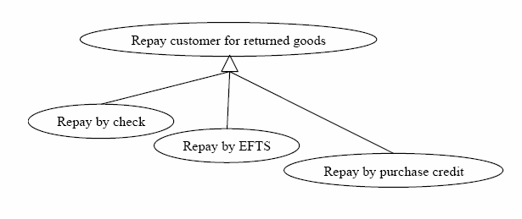
Technology & Data Variations
7. Repay customer for returned goods.
Technology & Data Variations List:
7a. Repay by check, EFTS, or credit against future purchases.
Main Success Scenario:
...
2. The user identifies him/herself, bank, and account #.
...
Technology & Data Variations List:
2a. Use magnetic bank card, eye scan, or fingerprints."
It is not extensions – it is rather specialization
Notes:
Extensions define what the system does differently. Sometimes, it is needed to express that "there are several different ways this can be done". What is the same, but how it is done might vary. This is usually because there are some different technology aspects, or some differences in the data representation. These variant are written into the Technology and Data Variations List section but not in the Extensions section.

Slide 61
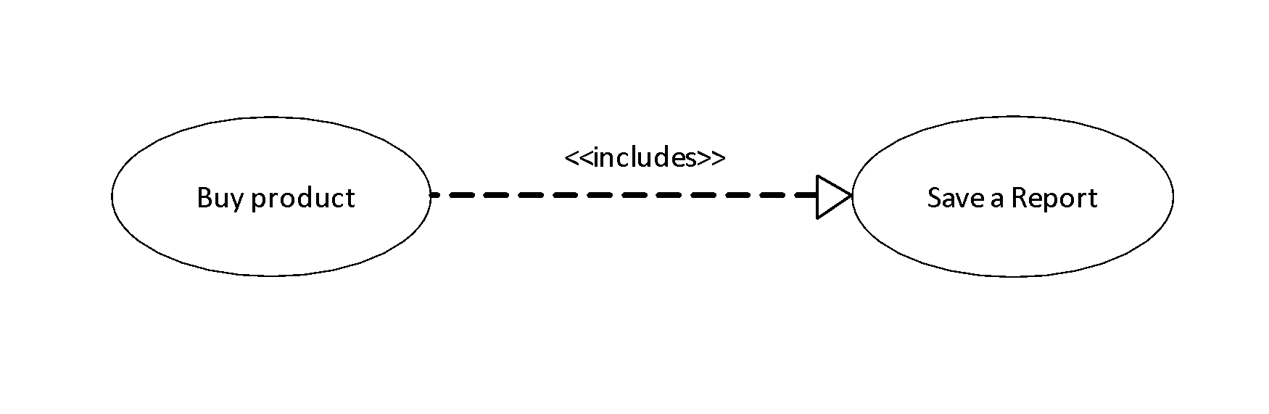
Linking Use Cases I
Sub use cases
Extension use cases
The user saves the report
The user saves the report (UC 35 Save a Report)
Notes:
An action step can be simple or reference to another use case. Writing in specific way indicates there is a use case called Save a Report.

Slide 62
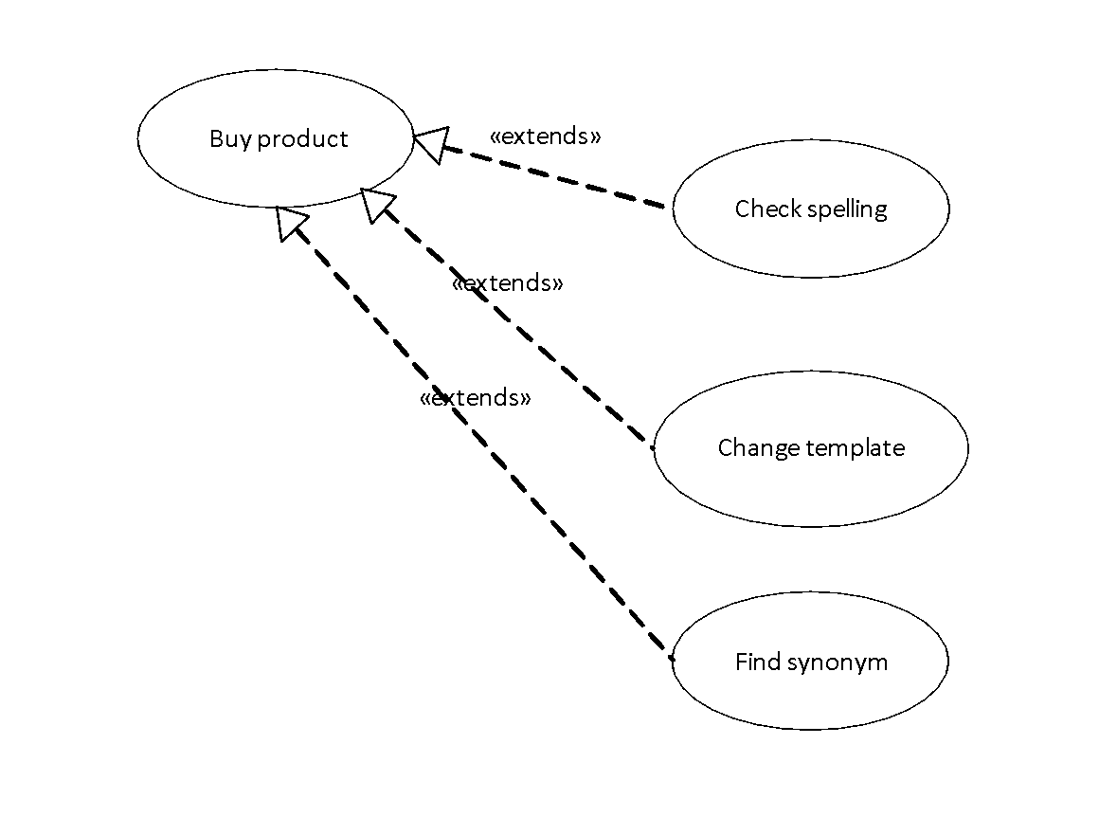
Linking Use Cases II
Sub use cases
Extension use cases
There is a main activity which can be interrupted.
It can be interrupted in a number of ways, without the main activity being in control of the interruptions.
Notes:
Example: Word processing example with spellchecker. The user’s main activity is typing. However, the user might suddenly decide to change the zoom factor or another activity.
Note: comment list
It is uninvited to explicitly name all the interrupting use cases in the base use case – the use case becomes messy and badly maintainable. Every time it gets edited, it might get corrupted, it needs to be versioned, reviewed, etc.
Create a new use case - extension use case. It starts with a condition, referencing a situation in the base use case where the condition might occur. Put all that into the Trigger section of the template.

Slide 63
When to use extension use case
Many asynchronous or interrupting services.
Adding to locked requirement document.
Notes:
Create extension use cases only when you need to. They are harder for people to understand and maintain. Two situations call for extension use cases.
When there are many asynchronous or interrupting services the user might use, which should not disturb the base use case (The most common use is). Often, they will be developed by different teams.
When you are writing additions to a locked requirements document.

Slide 64
When are we done?
You have named all the primary actors and all the user goals with respect to the system.
You can capture every trigger condition to the system either as a use case trigger or an extension condition.
You have written all the user-goal use cases, along with the summary and subfunction use cases needed to support them.
Each use case is clearly enough written that:
the sponsors agree they will be able to tell whether or not it is actually delivered.
the users agree that it is what they want or can accept as system’s behavior.
the developers agree they can actually develop that functionality.
The sponsors agree that the use case set covers all they want (for now).
Notes:
All primary actors are important to define because they should define their all user goals in context of created system.
It is necessary to capture every triggered condition to the system because we define how to system should react to the situations those differs from main scenario.
All defined user goals are important because we know which user function and sub function should be described by use cases and have implementation.
Finally, agreement between sponsors, users and developers is important. Sponsors agree what functionality they will pay for. Users agree what functionality they will be using. Developers agree what functionality they are able to develop.

Slide 65
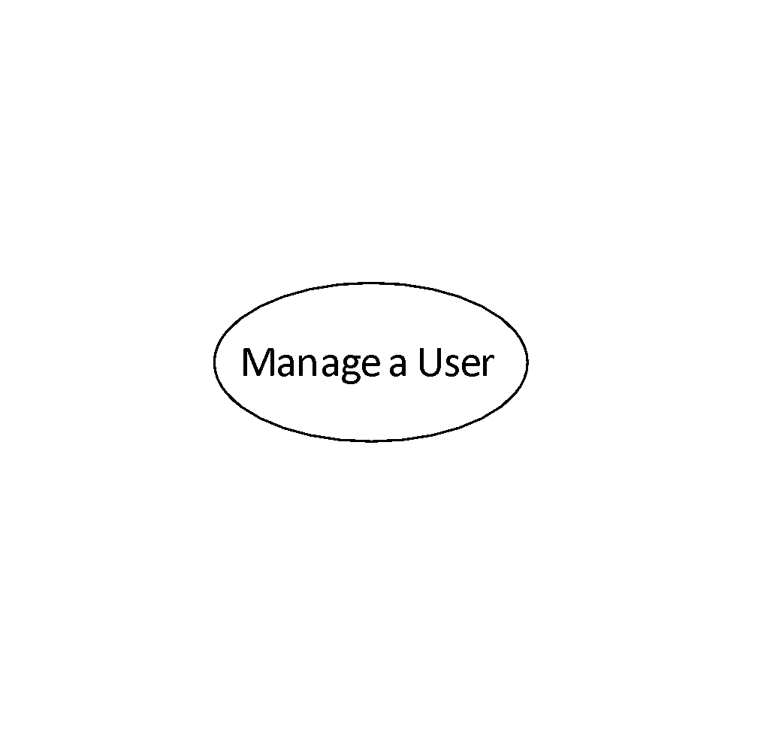
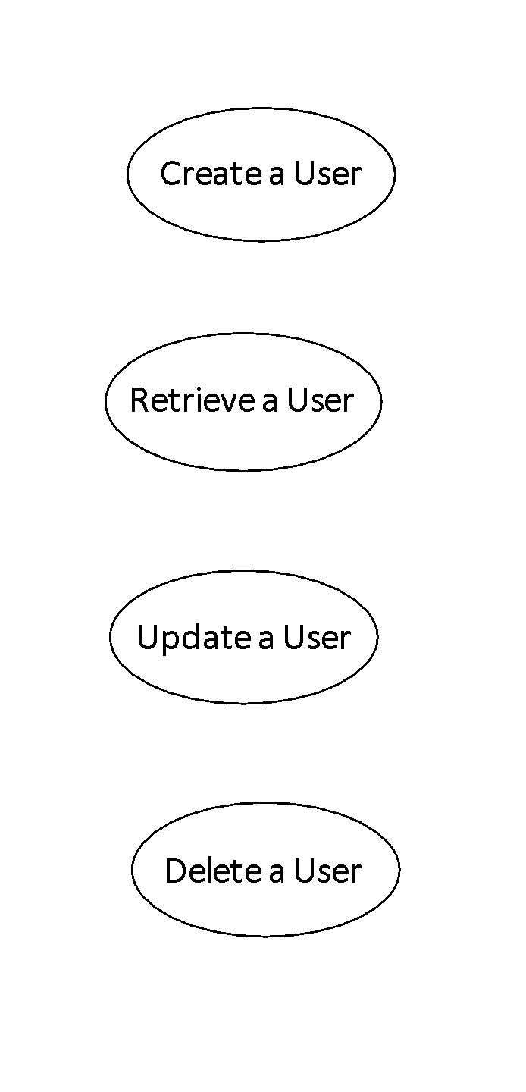
Special use cases: CRUD
Notes:
Advice is to keep this use cases separate if you need to keep track of which primary actors have security access to the different functions but start with just one Manage users. If writing of such a use case gets too complex, we set aside a certain part – similarly to a use case from an extension is created.

Slide 66
Special use cases: parameterized use cases I
Similar USE-CASES: Find a Customer, Find a Product, Find a Promotion differing in:
the name of the thing to be found
the searchable qualities (search fields) of the thing to be found
what to display about the thing to be found (the display values, in sequence)
how to sort the choices (sort criteria).
Notes:
Another typical class of use cases is use cases that do some generic action and just one development team will probably create the generic mechanism for them, and other teams will use it.
Writing half-a-dozen similar use cases is not much of a problem with casual use cases. However, writing six similar fully dressed use cases is not good – it introduced redundancy and cost a lot of effort.

Slide 67
Special use cases: parameterized use cases II
Similar USE-CASES: Find a Customer, Find a Product, Find a Promotion differing in:
the name of the thing to be found
the searchable qualities (search fields) of the thing to be found
what to display about the thing to be found (the display values, in sequence)
how to sort the choices (the sort criteria).
Generic USE-CASE: Find a Whatever
The clerk finds a customer using customer search details.
1. The user identifies the searchable qualities of the whatever thing.
2. The system finds all matching whatevers and displays their display values on a list.
3. The user can resort them according to the sort criteria.
4. The user selects the one of interest.

Slide 68
MISSING REQUIREMENTS
UC is only „third chapter of SRS“ – it doesn’t contain –
contain performance requirements,
business rules,
user interface design,
data descriptions,
finite state machine behavior,
priority, etc.
Could be attached:
use case priority,
expected frequency of occurrence,
performance needs,
delivery date,
list of secondary actors,
business rules (possibly),
open issues.
Additional table:
primary actor
trigger
delivery priority
estimated complexity
probable release
performance requirement
state of completion
...and whatever else you need.
Notes:
Use cases do not contain performance requirements, business rules, user interface design, data descriptions, finite state machine behavior, priority, and probably some other information.
Where are those? Some of them could be attached to each use case:
use case priority,
expected frequency of occurrence,
performance needs,
delivery date,
list of secondary actors,
business rules (possibly),
open issues.
Contained information depends on the project.
There is a simple spreadsheet or table with information in many cases. The table should contain – besides the name:
primary actor
Trigger
delivery priority
estimated complexity
probable release
performance requirement
state of completion
...and whatever else you need.

Slide 69
Data requirements
Required by programmers – includes field check
Three level of precision:
Information nicknames,
Field lists, or data descriptions,
Field details & checks.
Information nicknames will:
speed up the requirement gathering
make use cases shorter and easier to read
make use case more durable
Enable to refer the same information to other use cases.
Notes:
There are still missing requirements similarly important as behavioral requirements – the data requirements with field check to perform.
It is useful to divide the data requirements into three levels of precision:
Information nicknames,
Field lists, or data descriptions,
Field details & checks.

Slide 70
Data requirements: information nicknames
only a nickname is used in UC,
it will enable
speed up the requirement gathering,
make use cases shorter and easier to read,
make use case more durable
enable to refer the same information to other use cases.
Notes:
"Accountant enters customer’s name, address and phone number." Description of each name, address, and phone number is defined in some other place.
In use case, nicknames are only used:
to speed up the requirements gathering,
to make the use cases much shorter and easier to read,
and to make them also less brittle (sensitive to changes in the data requirements).
it is also likely that many use cases refer the same information nicknames.
Therefore, break the details of the data requirements out of the use case, and link from the use case to the relevant field list.

Slide 71
Data requirements: field list
describes what fields information links contain.
many strategies for dealing with this level of precision:
a separate entry for each entry
a single entry for a parcel of information that arrives in a single UC step together (name, address, phone number)
Notes:
It contains definition of nicknames - whether "customer's name", consists of two parts, first and last names, or three parts (or more)? What exactly is needed for "address"?
There are more strategies how to deal with level of precision:
to have a separate entry in your tool for each nicknamed item. We defined that "customer name" has three fields: the customer's first name, middle name, last name
to notice that parcel of information arrive together in a single use case step (e.g. name, address and phone number). This is useful information for the user interface designer, since it is quite likely that these three parcels of information will show up together.

Slide 72
Data requirements: Field details & checks
Data length specifications & data restrictions
Let‘s note:
Field details need to be expanded and checked
Use case is not a place for expansion
Use case should link to the expansion
The fields details usually change in time independently from use cases
Notes:
It is the last level of abstraction and it defines information as "How many characters long can the customer's name be?" and "What restrictions are there on Date of Loss?" These are field types, field lengths, and field checks.
Some teams put it into:
Data requirements or External Data Formats,
Field definitions
UI data details – interface requirements and design document.

Slide 73
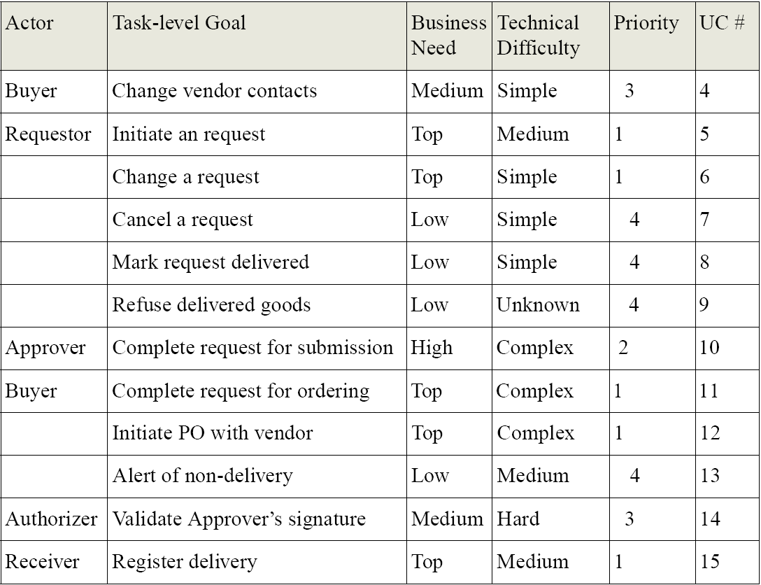
Use Cases In Project Organization: Organization of use cases
Analytic: names of use cases with names of primary actors
Sponsor: priority of business need
Developer: technical difficulty
Notes:
Project planning:
to create a table with the use case and primary actor names in the left two columns.
the business sponsors put the priority or value to the business of each use case.
the development team estimates the complexity or difficulty of delivering that function.
This is a natural evolution of Use cases. Over the time, complete the estimates for each use case, assign them to teams, and track the work per use case per release.

Slide 74
Use Cases In Project Organization: Use cases cross releases
A complete use case is delivered in one release very occasionally. More often:
Deliver the simple case in release 1
Add high-risk handling in release 2
Put preferred customer handling in release 3
Deliver complete scenario.
Notes:
A complete use case is delivered in one release very occasionally.
Either you write one use case and deliver a fraction of it in each release, or you write three use cases.
The use case says what the user wants to accomplish, and enumerates the many scenarios involved in accomplishing that. When you deliver software, you must deliver some of those scenarios top to bottom, or your application is not delivering usable function.
Planning and design must coincide to produce end-user usable collections of functions. Those are full scenarios from the use cases. Functional testers will test for use case compatibility.

Slide 75
Use cases to design - I
Design doesn’t cluster by use case – parts of business logic or mechanism occur in several use cases.
During OO design - don’t mirror functional decomposition by classes.
Notes:
Use cases describe in designed system all and only black-box behavioral requirements for the design to meet – designer has freedom in production of good design that meets the requirements.
Design doesn’t cluster by use case.
The design tasks do not map themselves exactly to use case units. A design task produces business objects or behavioral mechanisms which could be used in several use cases – for more details see available literature.
Object oriented design
Functional decomposition is good for requirement but it is not good for an object oriented design. Don’t mirror functional decomposition by classes. Experience shows it as a bad technique.

Slide 76
Use cases to design - II
Design makes use of scenarios
Use cases name domain concepts
Notes:
Design makes use of scenarios
Use cases also serve well with other design techniques, showing when the design is complete and handles all situations. Responsibility Based Design is based on designing while stepping through scenarios.
Use cases name domain concepts
Use cases fairly shout out the names of the domain objects involved. Consider the use case phrase:
"System produces an invoice, fills the invoice line items with their costs, adds tax and shipping
costs, and produces the total. The invoice footer states the terms of delivery."

Slide 77
UML diagrams limitations
Information conveyed by such diagrams has a tendency to be incomplete, imprecise and even inconsistent.
Diagrams cannot express the statements that should be a part of a specification.
Interpretation of a diagram can be ambiguous.

Slide 78
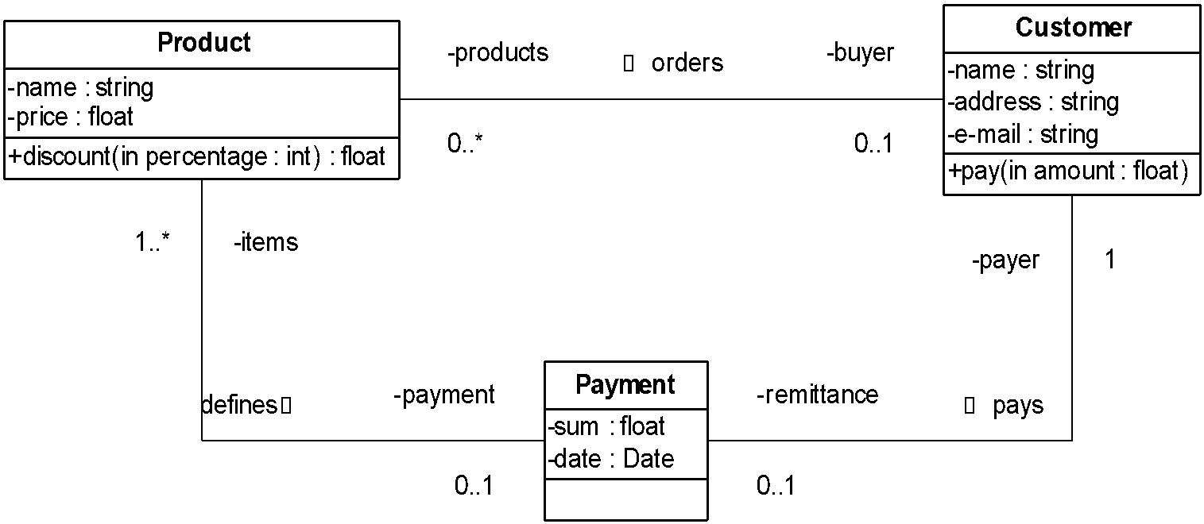
UML Limitations: Example

Slide 79
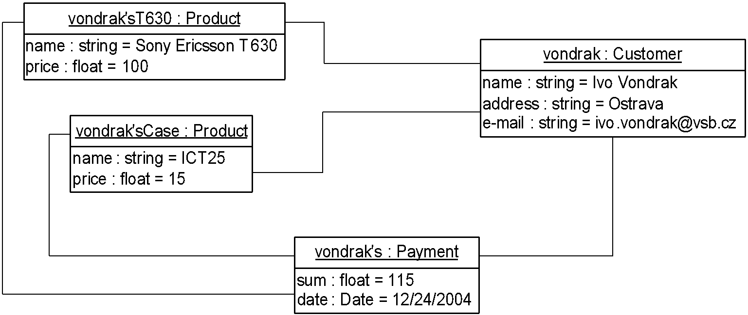
Correct Interpretation of Model

Slide 80
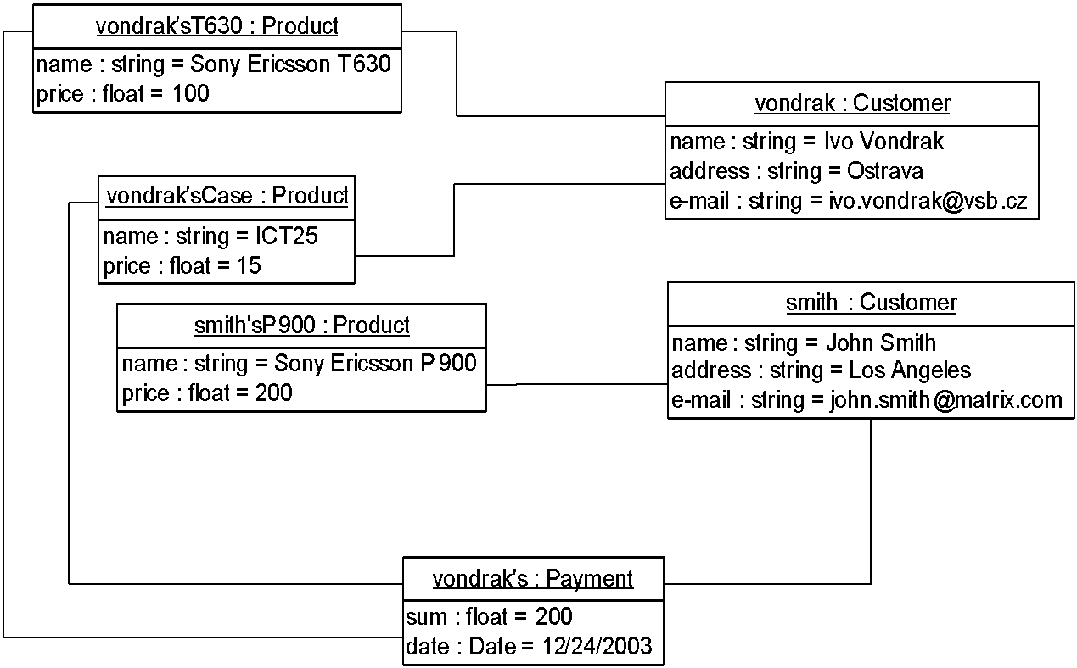
Mistaken Interpretation
Object vondrak should pay his products and the amount that has to be paid is given by the sum of both product. This interpretation is not valid but it is correct from the point of view of the class diagram. The class diagram is ambiguous!

Slide 81
OCL – Object Constraint Language
OCL is a language that can express additional and necessary information about models and other artifacts used in object-oriented modeling, and should be used in conjunction with UML diagrammatic models.
OCL is precise, unambiguous language that is easy for people who are not mathematicians or computer scientists to understand. It does not use any mathematical symbols, while maintaining rigor in its definition.
OCL is a typed language, because it must be possible to check an expression included in the specification without having to produce an executable version of the model.
OCL is a declarative, side-effects-free language; that is the state of a system does not change because of an OCL expression.
UML/OCL enables to build models completely platform-independent.
Notes:
Základní typy jsou – String, Real, Integer, Boolean. Kolekce

Slide 82
How to Combine UML and OCL
Rules related to the class diagram of an e-shop:
A payment is valid only when the products ordered by a customer are paid by the same customer.
The e-mail address has to be unique.
The payment sum is given by the sum of all ordered products’ prices.
The customer has to pay the amount of money equal to the payment sum.

Slide 83
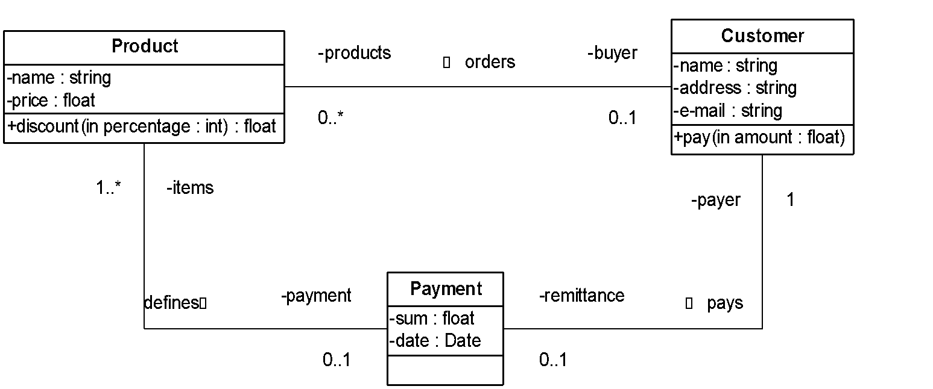
OCL Expressions
Rules related to the class diagram of an e-shop:
A payment is valid only when the products ordered by a customer are paid by the same customer.
The e-mail address has to be unique.
The payment sum is given by the sum of all ordered products’ prices.
The customer has to pay the amount of money equal to the payment sum.
context Payment inv: self.items->forAll (item | item.buyer = payer)
context Customer inv: Customer::allInstances()->isUnique(e-mail)
context Payment inv: self.items.price->sum() = self.sum
context Customer::pay(amount: float) pre: self.remittance.sum = amount

Slide 84
OCL anatomy
context <Context for expressions>
<type of OCL>: <expressions>
Types of OCL constructions:
inv – invariants
pre, post – pre and post condition
derive – derived attribute
body – query functions
Init – initial value

Slide 85
Types in OCL
Boolean
Integer
Real
String
User defined – classes, enumeration
Collection

Slide 86
Boolean operators
Simple operators
a or b
a and b
a xor b
not a
a implies b
a = b
a <> b
Ternary operatory
if <boolean OCL expression>
then <OCL expression>
else <OCL expression>
endif

Slide 87
Integer and Real operators
=,<>, <, >, <=, >=, +, -, *, /
a.mod(b), a.div(b) , a.abs(), a.max(b), a.min(b), a.round(), a.floor(),
2654 * 4.3 + 101 = 11513.2
(3.2).floor() / 3 = 1
1.175 * (-8.9).abs() - 10 = 0.4575
12 > 22.7 = false
12.max(33) = 33
33.min(12) = 12
13.mod(2) = 1
13.div(2) = 6
33.7.min(12) = 12.0
-24.abs() = 24
(-2.4).floor() = -3

Slide 88
String operators
string1.concat(string2), string.size(), string.toLower(), string.toUpper(), string.substring(int1, int2), string1 = string2, string1 <> string2
'Anneke'.size() = 6
('Anneke' = 'Jos') = false
'Anneke '.concat('and Jos') = 'Anneke and Jos'
'Anneke'.toUpper() = 'ANNEKE'
'Anneke'.toLower() = 'anneke'
'Anneke and Jos'.substring(12, 14) = 'Jos'

Slide 89
Invariants
An invariant is a constraint – a boolean expression - that should be true for an object during its complete lifetime.
Invariants on attributes context Product inv ofPrice: self.price >= 0
Invariants on associated objects context Payment inv ofAge: payer.age >= 18
Keyword self means reference to a given instance. Its use is mandatory in the case of ambiguity only.

Slide 90
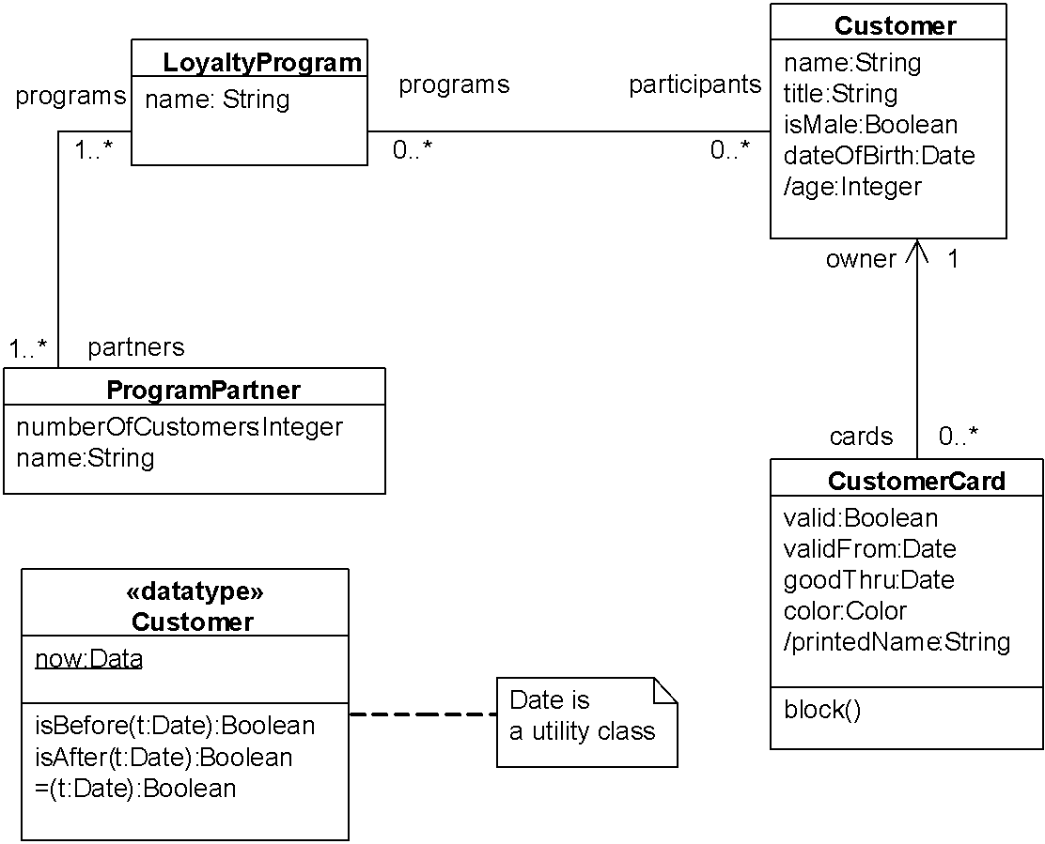
Attribute age of every customer object must be equal to or greater than 18.
context Customer
inv ofAge: age >= 18

Slide 91
validFrom should be earlier than goodThru.
context CustomerCard
inv checkDates: validFrom.isBefore(goodThru)

Slide 92
Working with association I.
Multiplicity at least one enables direct access to object.
result of expression “self.payer.name” in context of Payment is the name of Customer associated with Payment

Slide 93
Every owner of CustomerCard has age greater than or equal to 18.
context CustomerCard
inv ofAge: owner.age >= 18

Slide 94
Working with association II.
When the multiplicity of an association is greater than 1, OCL provides a wide range of collection operations:
basic operations
loop operations.
These operations are accessible in the following way:
collection->operation()

Slide 95
Standard collection operators
count( object ) -The number of occurrences of the object in the collection
excludes( object ) -True if the object is not an element of the collection
excludesAll( collection) -True if all elements of the parameter collection are not present in the current collection
includes( object ) - True if the object is an element of the collection
includesAll( collection) - True if all elements of the parameter collection are present in the current collection
isEmpty() - True if the collection contains no elements
notEmpty() - True if the collection contains one or more elements
size() - The number of elements in the collection
sum() - The addition of all elements in the collection. The elements must be of a type supporting addition (such as Real or Integer).

Slide 96
Only a customer associated to some programs could have some cards – every customer with at least one card is associated to some program
context Customer
inv minServices: self.cards->size() > 1 implies self.programs->size() > 1

Slide 97
Loop operations
collect(expr)…collection of objects that result from evaluating expr for each element in the source collection
exists(expr)…true if there is at least one element in the source collection for which expr is true
forAll( expr )…true if expr is true for all elements in the source collection
isUnique( expr )…true if expr has a unique value for all elements in the source collection
one( expr) … true if there is exactly one element in the source collection for which expr is true
select(expr)…subcollection of the source collection containing all elements for which expr is true

Slide 98
The number of valid cards for every customer must be equal to the number of programs in which the customer participates.
context Customer
inv sizesAgree:
programs->size() = cards->select( valid = true )->size()

Slide 99
Iterator Variables
Every iterator operation may have an extra (optional) parameter, an iterator variable. An iterator variable is a variable that is used within the body parameter to indicate the element of the collection for which the body parameter is being calculated.
context Customer inv: Customer::allInstances()->isUnique(e-mail)
or
context Customer inv: Customer::allInstances()->isUnique(c | c.e-mail)
or
context Customer inv: Customer::allInstances()->isUnique(c:Customer | c.e-mail)

Slide 100
Types of collections
OCL defines types of collection:
Set - a collection that contains instances of a valid OCL type and does not contain duplicate elements
OrderedSet – Set with ordering of elements
Bag - a collection that may contain duplicate elements
Sequence - Bag whose elements are ordered
Specific operation for collection are provided
append(object),prepend(object) … add on the end resp. start
asBag(), asOrderedSet(), asSequence(), asSet() … casting
at(index), first(), last() … gets given item
including(object), excluding(object) … add resp. remove item
flatten … change a collection of a collection to a single collection

Slide 101
Attribute numberOfCustomers holds the number of customers who participate in one or more loyalty programs offered by this program partner
context ProgramPartner
inv nrOfParticipants:
self.numberOfCustomers =
self.programs.participants->flatten()->asSet()->size()

Slide 102
Preconditions and Postconditions
Preconditions and postconditions are constraints that specify the applicability and effect of an operation without stating an algorithm or implementation.
context Product::discount(percentage: Integer) : Real pre: percentage >= 0 and percentage <= 10 post: let oldPrice : Real = self.price@pre in self.price = oldPrice – (oldPrice*percentage/100) and result = self.price

Slide 103
Consider method CustomerCard::block – value of valid is set to false and old value of the attribute is returned.
context CustomerCard::block():boolean
post: self.valid =false and
result = self.valid@pre

Slide 104
Information addition
Definition of already declared elements in a class diagram:
Query function
context Product::possibleDiscount(percentage: Integer) : Real body: self.price – (self.price*percentage/100)
Derived attributes
context Project::duration: Integer derive: self.end.diference(self.start)
Definition of new elements – query function and derived attributes
context Department
def completeBudget : Real = self.project.budget->sum();

Slide 105
Derived attribute printedName of CustomerCard is determined based on the name and title of the card owner.
context CustomerCard::printedName:String
derive: self.owner.title.concat(' ').concat(self.owner.name)

Slide 106
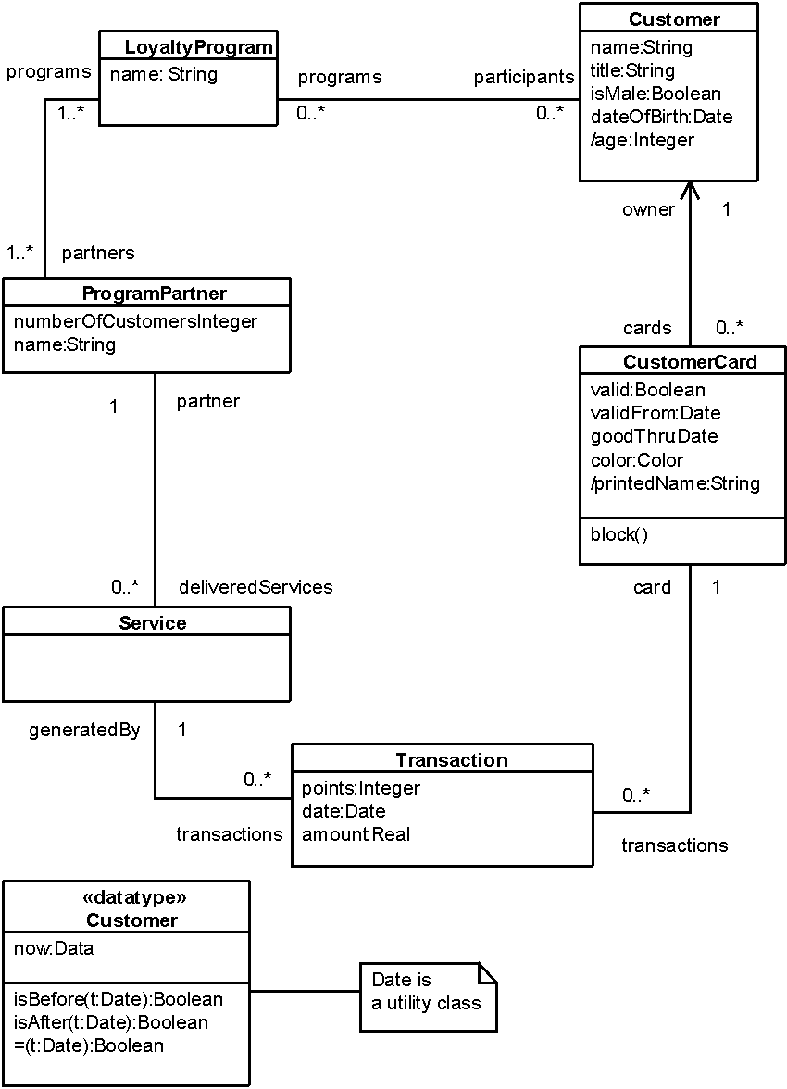
Let‘s introduce a derived attribute called turnover in class Service which would sum the amount attributes of the transactions on the account.
context Service
def: turnover : Real
= self.transactions.amount->sum()

Slide 107
Initial values
Attributes
context CustomerCard::valid : Boolean
init: true
Association role
context Customer::products : Set( Products)
init: Set{}

Slide 108
A new CustomerCard is valid if and only if owner has already at least another one card.
context CustomerCard::valid: Boolean
init: self.owner.cards->exists(c| c != self and c.valid)

